Slide 1

Stereo-seq downstream bioinformatics analysis
STOmics Americas
2024/05

Slide 2


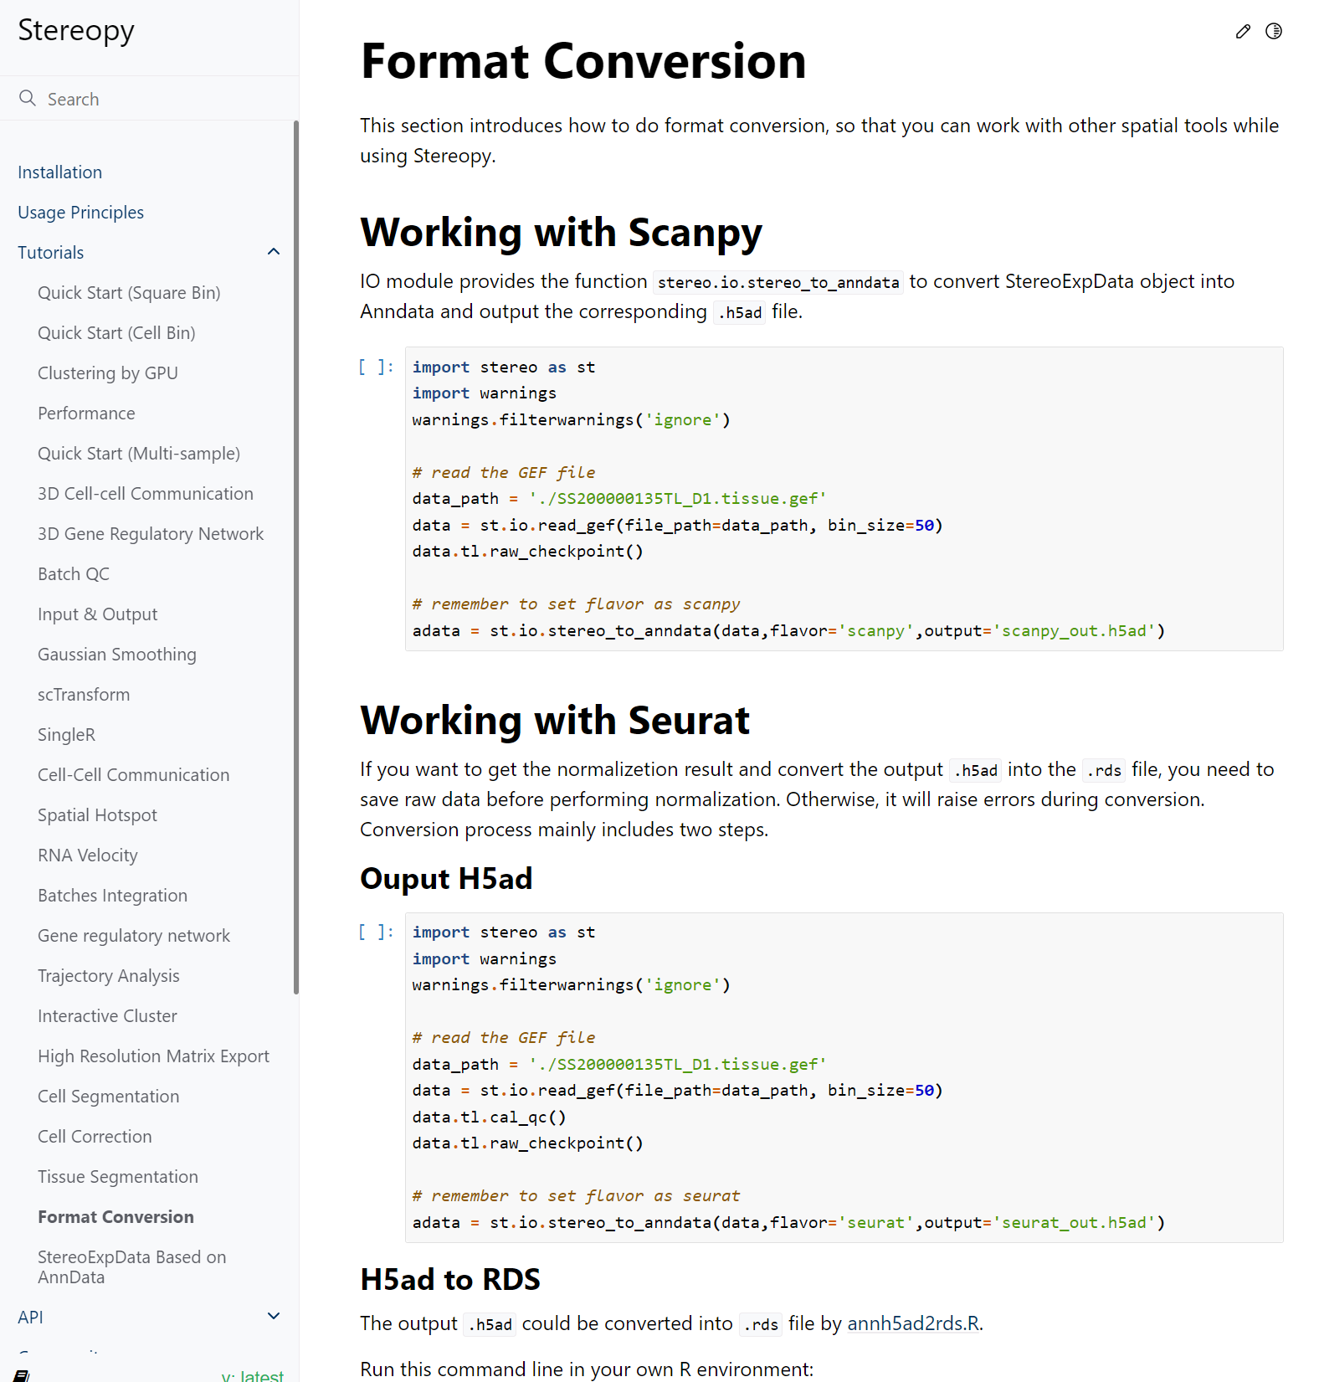
Stereopy
https://stereopy.readthedocs.io/en/latest/
Converting stereo-seq file for Seurat or Scanpy

Slide 3
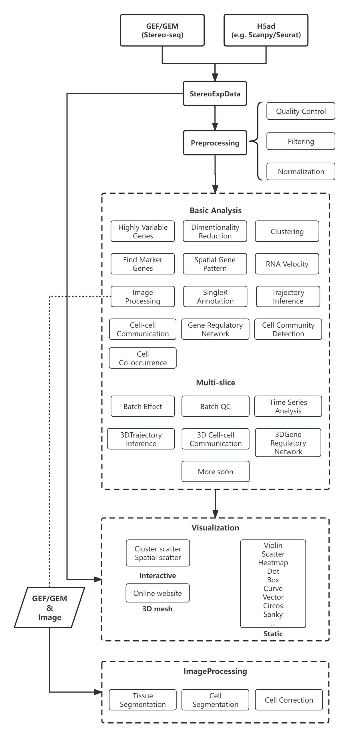
Stereopy
https://stereopy.readthedocs.io/en/latest/

Slide 4
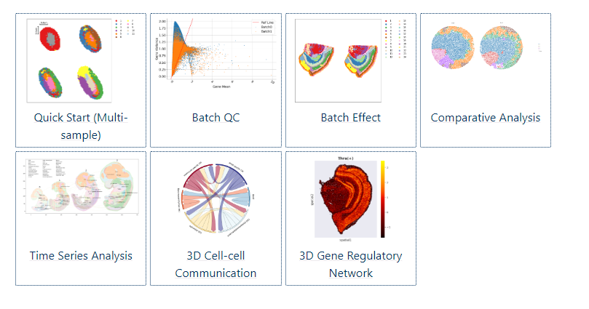
Stereopy
https://stereopy.readthedocs.io/en/latest/

Slide 5
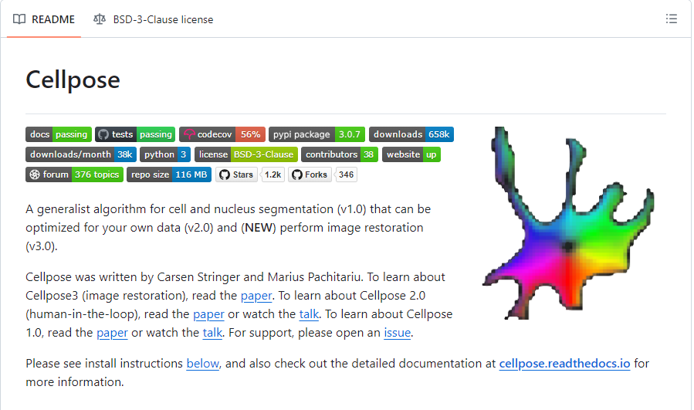
Cell segmentation

Slide 6
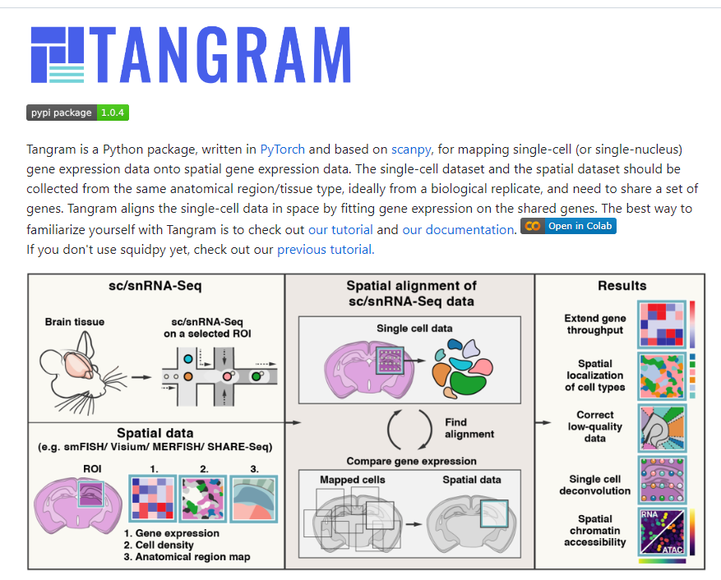
Single cell segmentation
https://tangram-sc.readthedocs.io/en/latest/

Slide 7
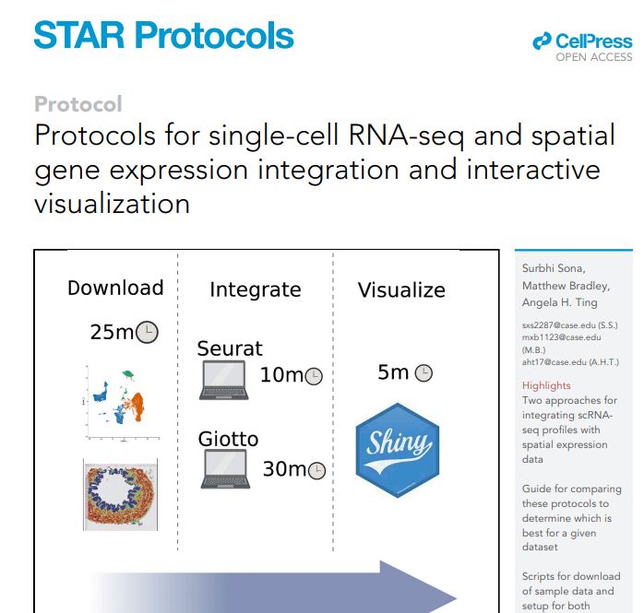
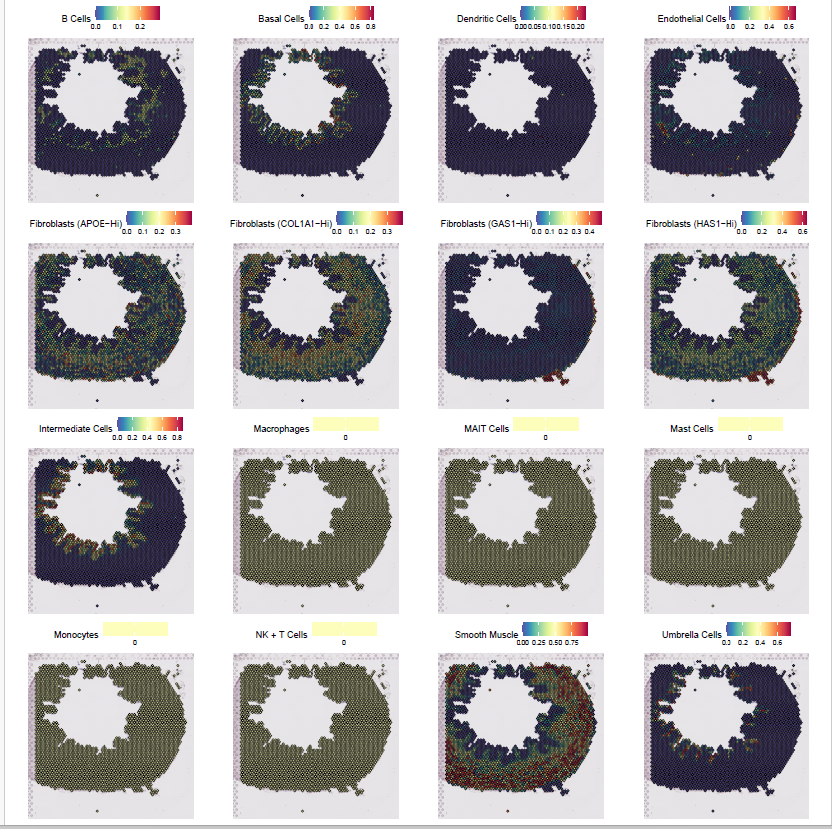
Single cell integration
https://www.ncbi.nlm.nih.gov/pmc/articles/PMC9871342/

Slide 8

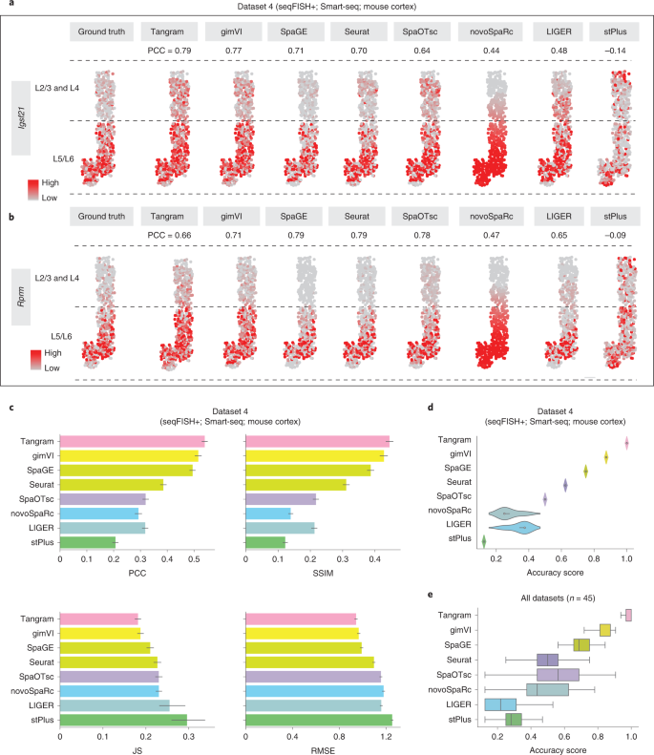
Single cell integration

